Slide 1

CONICS

Slide 2

Construct of an Ellipse by Eccentricity Method
Construct an ellipse when the distance of the
Focus from the directrix is equal to 50mm and eccentricity is 2/3
1
Eccentricity is 2/3 = 0.667
A
2
e= 2/3 = VF/CV
4
3
F= 2+3 = 5
B

Slide 3
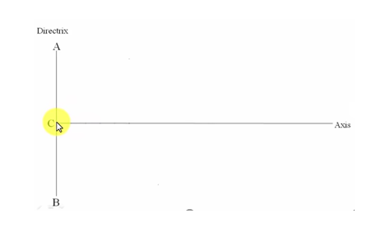
Construct of an Ellipse by Eccentricity Method
5

Slide 4
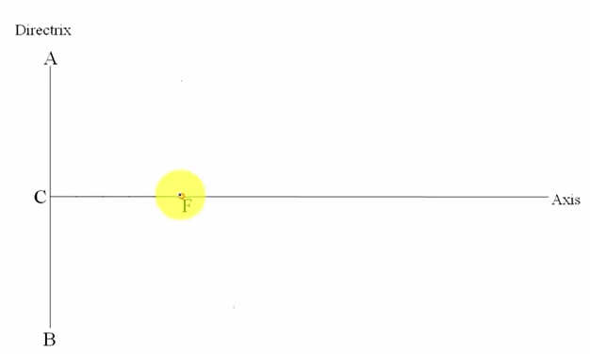
Construct of an Ellipse by Eccentricity Method
6

Slide 5
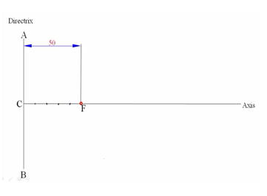
Construct of an Ellipse by Eccentricity Method
F= 2+3 = 5
7

Slide 6
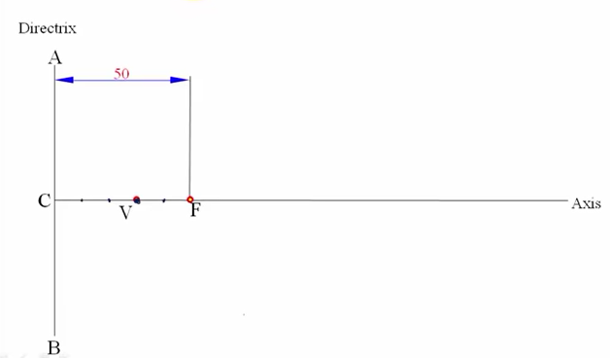
Construct of an Ellipse by Eccentricity Method
e= 2/3 = VF/CV
8

Slide 7
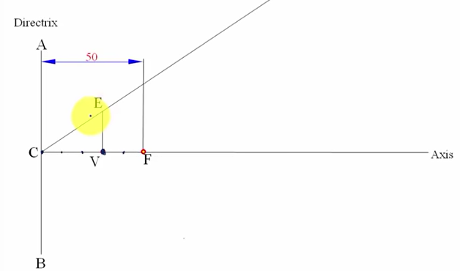
Construct of an Ellipse by Eccentricity Method
9

Slide 8
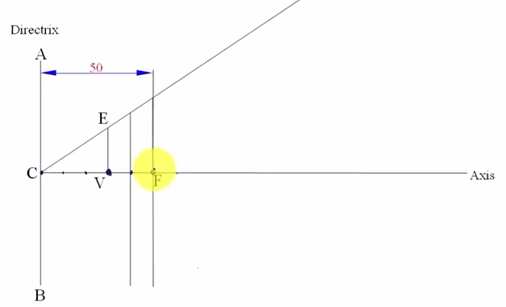
Construct of an Ellipse by Eccentricity Method
10

Slide 9
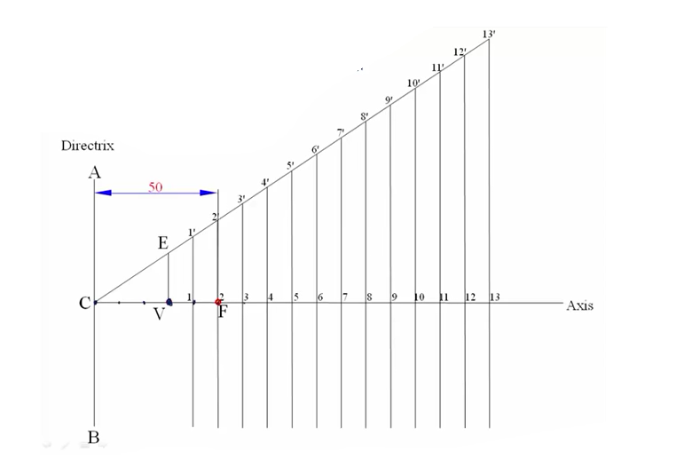
Construct of an Ellipse by Eccentricity Method
11

Slide 10
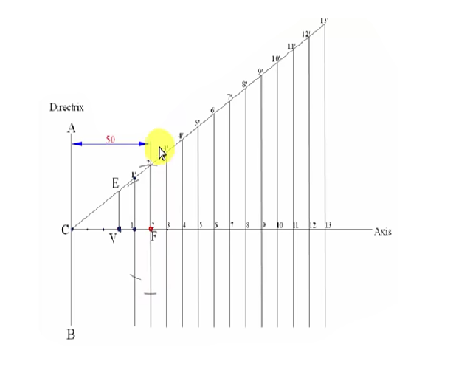
Construct of an Ellipse by Eccentricity Method
Take Arc of Radius | Put an Arc with F as Centre
1- 1’
2- 2’
3- 3’ Condt’s
12

Slide 11
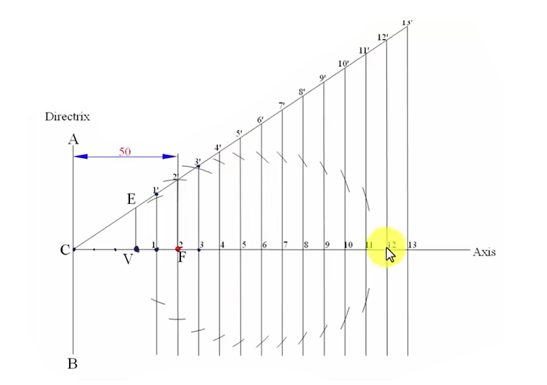
Construct of an Ellipse by Eccentricity Method
Take Arc of Radius | Put an Arc with F as Centre
1- 1’
2- 2’
3- 3’ Condt’s
13

Slide 12
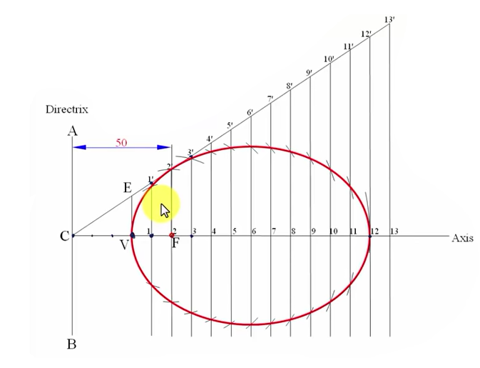
Construct of an Ellipse by Eccentricity Method
14

Slide 13
Construct of an Hyperbola by Eccentricity Method
Construct an Hyperbola when the distance of the
Focus from the directrix is equal to 50mm and eccentricity is 3/2
1
Eccentricity is 3/2 = 1.5
A
2
e= 3/2 = VF/CV
4
3
F= 3+2 = 5
B

Slide 14
Construct of an Hyperbola by Eccentricity Method
5

Slide 15
Construct of an Hyperbola by Eccentricity Method
6

Slide 16
Construct of an Hyperbola by Eccentricity Method
F= 3+2 = 5
7

Slide 17
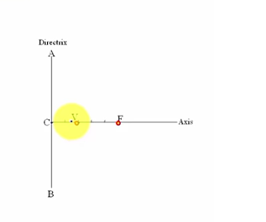
Construct of an Hyperbola by Eccentricity Method
e= 3/2 = VF/CV
8

Slide 18
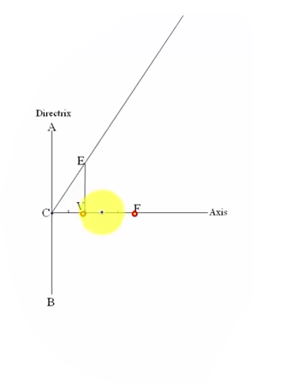
Construct of an Hyperbola by Eccentricity Method
9

Slide 19
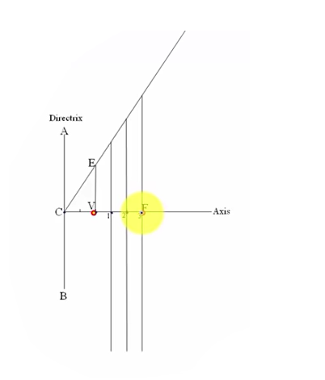
Construct of an Hyperbola by Eccentricity Method
10

Slide 20
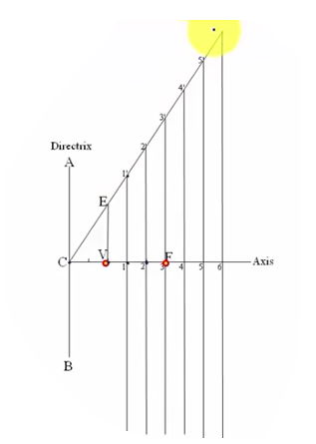
Construct of an Hyperbola by Eccentricity Method
11
12

Slide 21
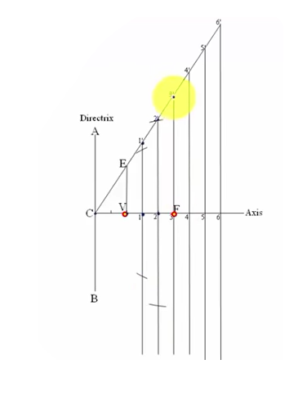
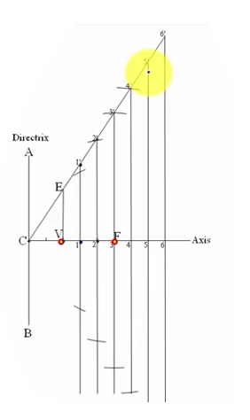
Construct of an Hyperbola by Eccentricity Method
13
14

Slide 22
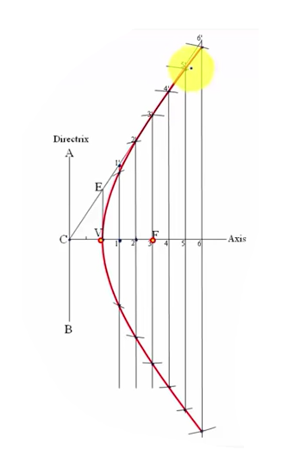
Construct of an Hyperbola by Eccentricity Method
15

Slide 23
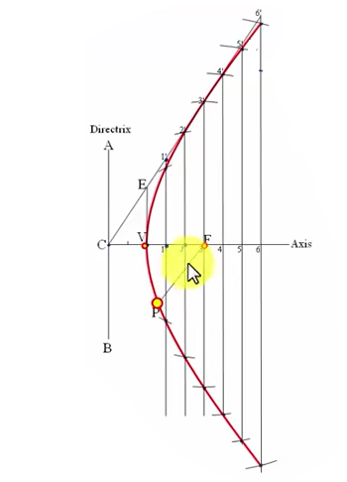
Construct of an Hyperbola by Eccentricity Method
16

Slide 24
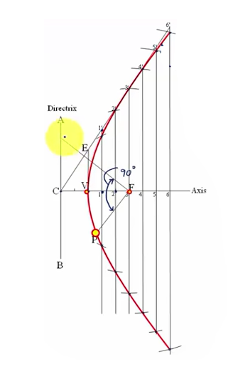
Construct of an Hyperbola by Eccentricity Method
17

Slide 25
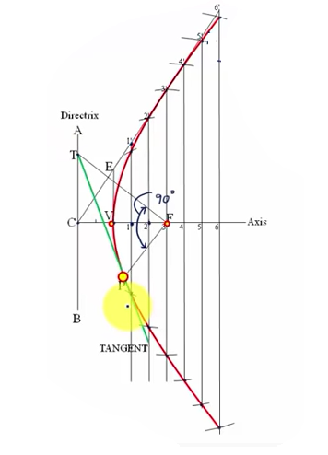
Construct of an Hyperbola by Eccentricity Method
18

